Slide 1


MNIST Digits Classification with Machine Learning
Priyanshu Sharma

Slide 2

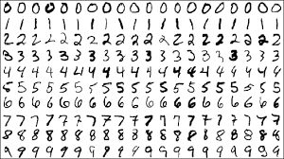
GOAL
The goal is to write an algorithm that detects which digit is written. Since there are only 10 digits (0, 1, 2, 3, 4, 5, 6, 7, 8, 9), this is a classification problem with 10 classes.
Our goal would be to build a neural network with 2 hidden layers.
MNIST DATASET
The dataset provides 70,000 images (28x28 pixels) of handwritten digits (1 digit per image)
This dataset is available in different libraries like TensorFlow, sci-kit library, etc,

Slide 3

Action Plan
Prepare our data and preprocess it. Create training, validation, and testing dataset.
Outline the model and choose the activation function.
Set the appropriate optimizer and loss function.
Make the model learn.
Test the accuracy of the model.

Slide 4
APPROACH TO BUILD THE MODEL
First, we convert images in vectors of 784*1 length each with value of range(0 to 255).
Then, we apply some preprocessing tricks i.e., shuffling and batching the dataset.
We built the model using "ADAM" optimizer and "SoftMax" as output activation functions.
We used One hot encoding method for categorical data preprocessing.
The final test accuracy should be roughly around 97%.

Slide 5


Slide 6
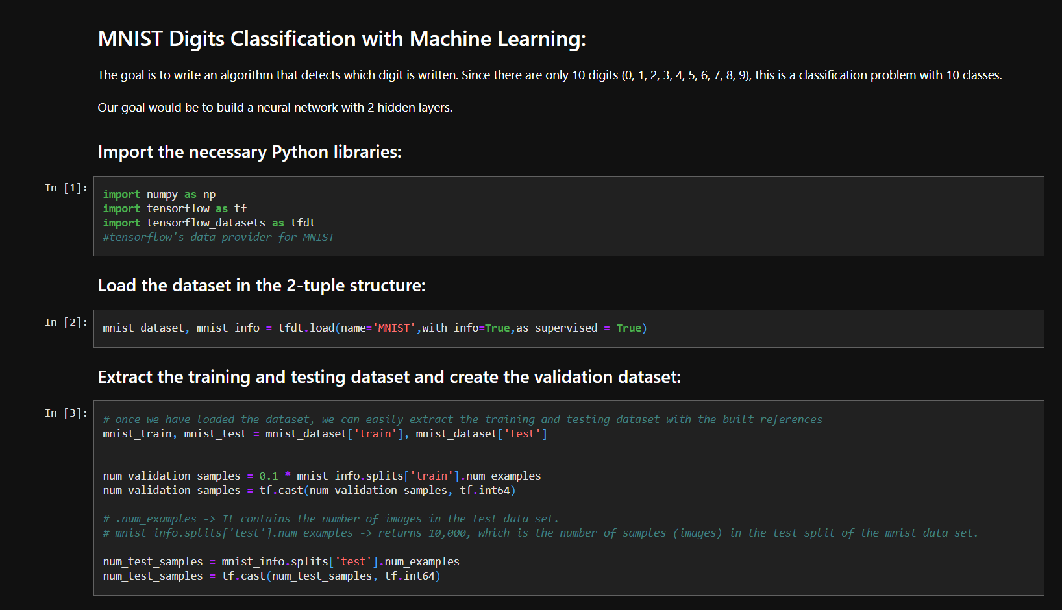

Slide 7
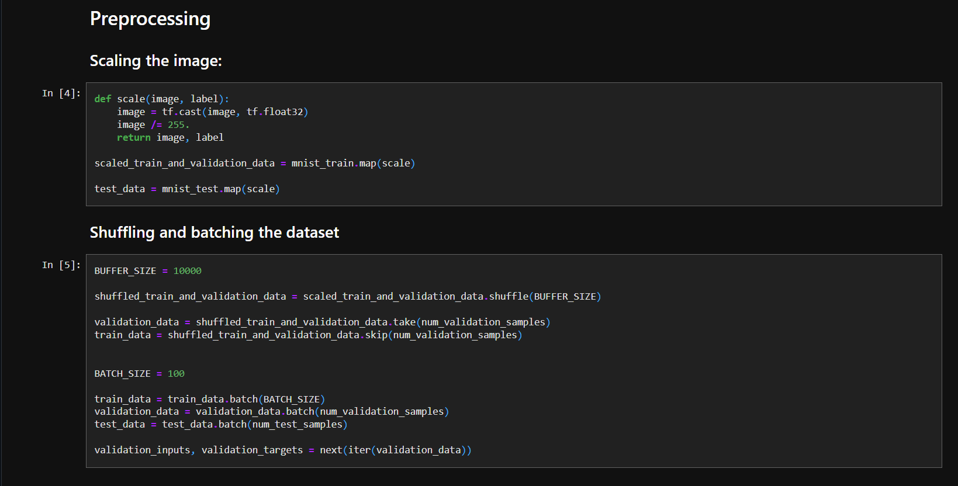

Slide 8
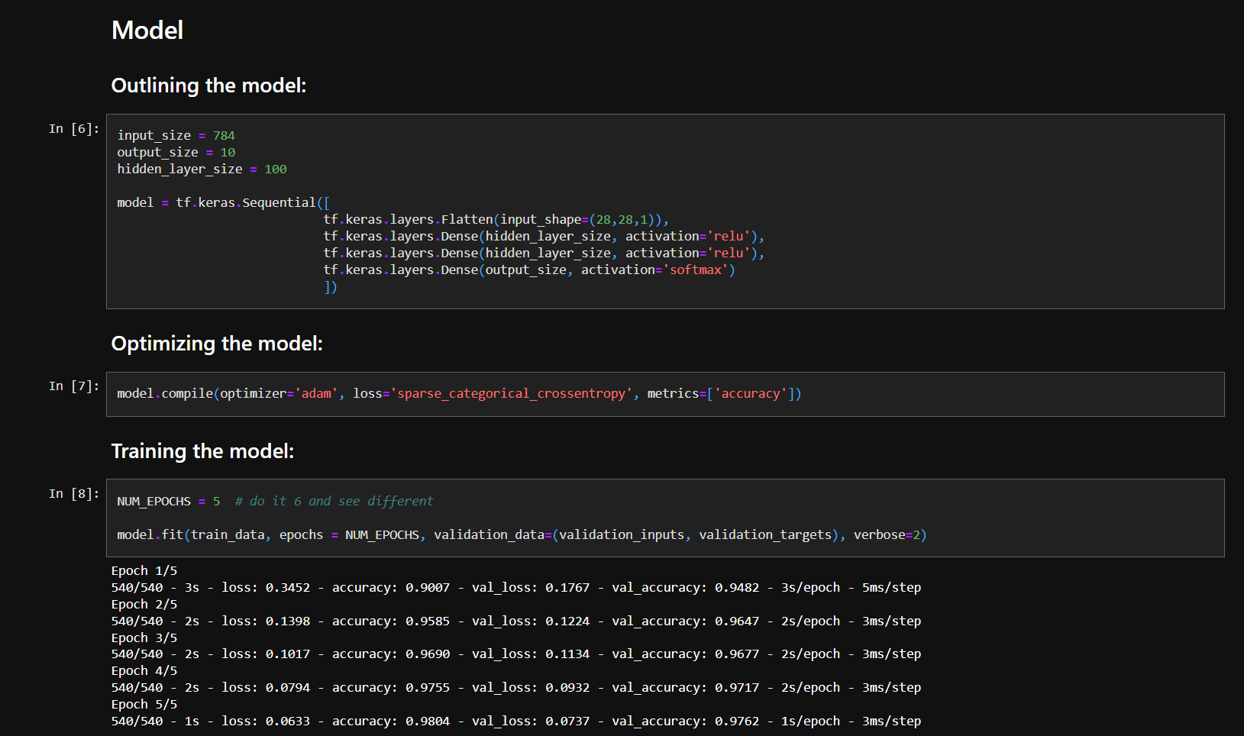

Slide 9
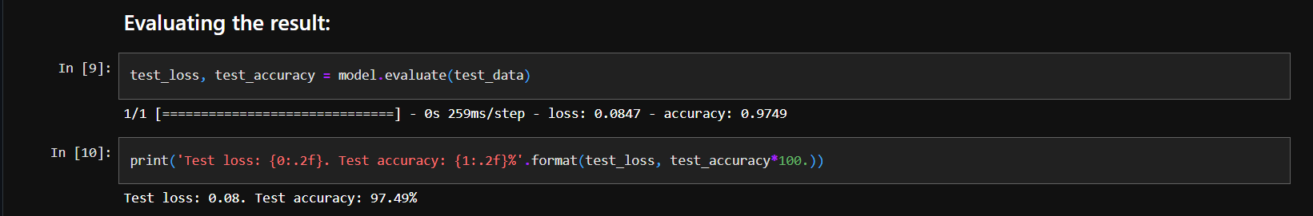

Slide 10


